Slide 1
Cross-Origin Resource Sharing OAuth and User Authentication

Slide 2
Objectives
Use the CORS NPM module to enable CORS support
Enable your Express application to support CORS requests by configuring the CORS module
Use an OAuth providers for authenticating users within your server
Set up your server using Passport OAuth modules to enable user authentication using OAuth providers

Slide 3
Cross-Origin Resource Sharing (CORS)

Slide 4
Same-Origin Policy
Web app security model that restricts how a document or script loaded from one origin can interact with a resource from another origin
– Isolating potentially malicious documents
Origin defined by three tuple: (Protocol, host name, port number)

Slide 5
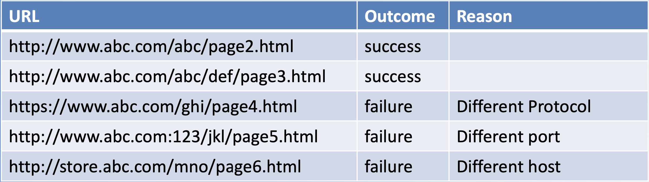
Same-Origin Policy
Example: from page http://www.abc.com/xyz/page.html

Slide 6
Cross-Origin Requests
Cross-origin HTTP request: Accessing a resource from a different domain, protocol or port
Browsers restrict cross-origin HTTP requests initiated from within scripts, e.g., XMLHttpRequest or Fetch

Slide 7
Cross-Origin Resource Sharing (CORS)
Mechanism to give web servers cross-domain access controls
– Browser and server can interact to determine whether or not it is safe to allow the cross-origin request
– New set of HTTP headers that allow servers to describe the set of origins that are permitted to read the information using a web browser
Access-Control-Allow-Origin
Access-Control-Allow-Credentials
Access-Control-Allow-Headers etc.

Slide 8
Cross-Origin Resource Sharing (CORS)
Simple cross-site requests:
GET or POST with request body containing application/x- www-form-urlencoded, multiplart/form-data or text/plain
No custom headers
For widely accessed resources like GET, can send back reply with Access-Control-Allow-Origin: * header
If need to restrict the access, then send reply with Access- Control-Allow-Origin: http://abc.com

Slide 9
Cross-Origin Resource Sharing (CORS)
Preflighted Requests
Methods that can cause side-effects on server’s data: non GET or POST, or even POST with content-type other than mentioned earlier
Mandated to “preflight” the request by soliciting the server’s supported methods by sending a HTTP OPTIONS request method
Then upon “approval” from the server sending the actual request
Server response may include Access-Control-Allow-Methods, Access- Control-Allow-Headers, Access-Control-Allow-Credentials

Slide 10
Cross-Origin Resource Sharing (CORS)
Credentialed Requests
Requests that are accompanied by Cookies or HTTP Authentication information
Server needs to respond with Access-Control-Allow- Credentials: true
Accces-Control-Allow-Origin header cannot have a wildcard “*” value, must mention a valid origin domain

Slide 11
CORS Node Module
Middleware to configure CORS with various options
Installing: npm install cors --save
Simple CORS enabling all CORS requests
Enabling CORS for specific routes
Configuration options for various headers

Slide 12
Exercise - Cross-Origin Resource Sharing

Slide 13
OAuth and User Authentication

Slide 14
OAuth 1 and OAuth 2
Authorization framework based on open standards for Internet users to log into third party websites/apps using their Social Network accounts
Facebook, Google, Twitter, Microsoft, Instagram, Github, DigitalOcean and many others
OpenID is a related but complementary service

Slide 15
OAuth 1 and OAuth 2
OAuth 1 protocol: – First evolved from Twitter (Blaine Cook) – IETF RFC 5849
OAuth 2 protocol: – Focuses on simplifying client development – IETF RFC 6749 – Bearer token usage IETF RFC 6750

Slide 16
OAuth 2 Roles
Resource owner: You, the user that authorizes a client application to access their account
Client Application: Application (website or app) that wants access to the resource server to obtain information about you
Resource Server: Server hosting protected data (e.g., your personal information)
Authorization Server: Server that issues an access token to the client application to request resource from the resource server

Slide 17
OAuth 2 Tokens
Access token: allows access to user data by the client application
Has limited lifetime
Need to be kept confidential
Scope: parameter used to limit the rights of the access token
Refresh token: Used to refresh an expired access token

Slide 18
Client Application Registration
Register the client application on the OAuth service provider:
Client App Id
Client Secret
Redirect URL: URLs for the client for receiving the authorization code and access token

Slide 19
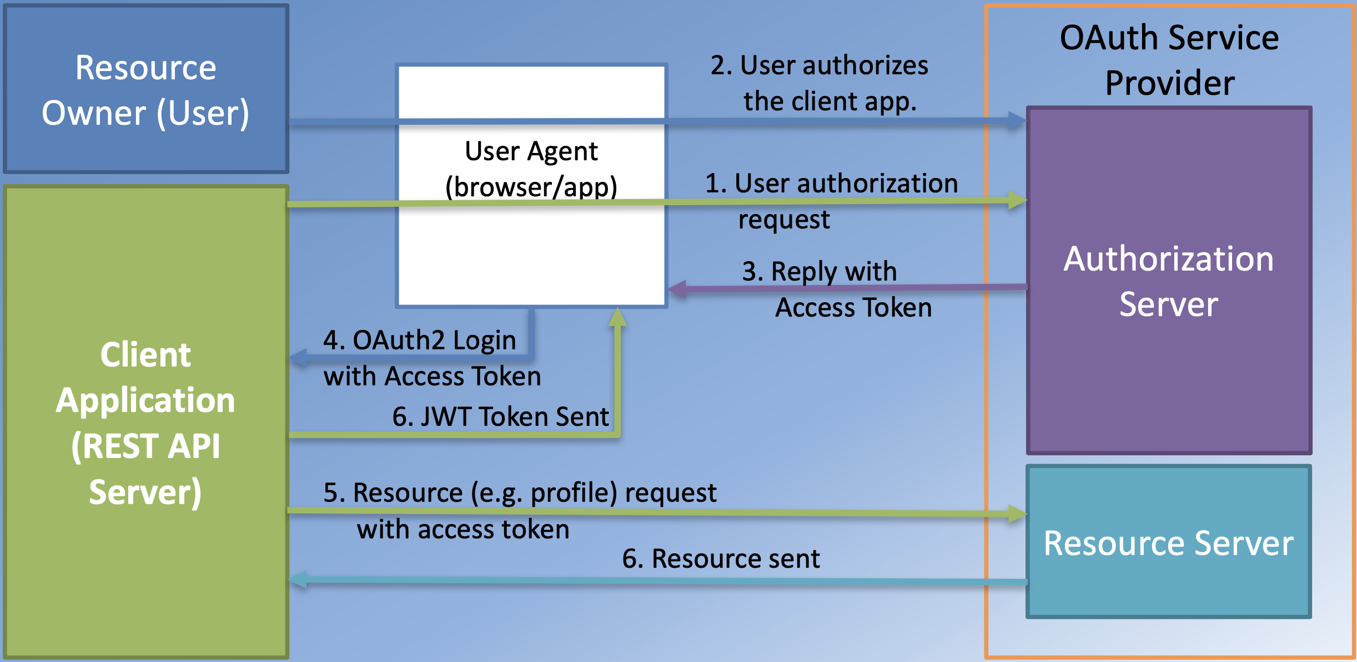
Implicit Flow Grant Approach (adapted)

Slide 20
Passport-Facebook-Token Module
Passport strategy for authenticating with Facebook using OAuth 2.0 API
Installing: npm install passport-facebook-token –save
Using var FacebookStrategy = require('passport-facebook-token');

Slide 21
Exercise - OAuth and User Authentication

Slide 22
Summary
Install and configure the CORS Node module
Configure your Express application to use the CORS module to support CORS on various endpoints
Configure your server to support user authentication based on OAuth providers
Use Passport OAuth support through the passport-facebook-token module to support OAuth based authentication with Facebook for your users.

